Slide 1

SARASWATI COLLEGE, SHEGAON DEPARTMENT OF BACHELOR OF COMPUTER APPLICATION
Project Title:- Plug And Play
Presented By:-
Abhishek Arun Kapade
Guide By:-
Mr. Akash Kharat

Slide 2
Topic Name
About
Introduction
System Requirement
Data Flow Diagram
Screenshot
Future Scope
Conclusion

Slide 3
About:-
Plug & play is a cutting-edge project that uses a raspberry pi zero W and the p4wnp1 A.L.O.A. HID attack to scan your system for infected files. By calculating the MD5 hash of each EXE and DLL file on your drive and comparing it to a list of virus hashes stored in a text file, plug & play quickly and efficiently detects and eliminates any threats.
Our automated process eliminates the need for manual scanning and removes the risk of user error. Simply plug the device into your computer and let plug & play do the rest. If any infected files are found, the script will alert you and automatically delete the virus, restarting your computer for a clean slate.

Slide 4
Introduction:-
Plug and play is the antivirus system, a customized solution for windows systems using kali Linux, p4wnp1 A.L.O.A toolkit, and hid script on raspberry pi zero w. This system is designed to provide a user-friendly and efficient way to detect and remove malicious files from windows systems.
In today's digital age, cybersecurity threats are becoming increasingly sophisticated and common. As a result, it is essential to have a robust and reliable antivirus system to protect windows systems from potential threats. The plug and play antivirus system is an innovative solution that combines the power of kali Linux, raspberry pi zero w, p4wnp1 A.L.O.A toolkit, and hid script to provide a comprehensive and efficient antivirus solution.

Slide 5
System Requirement:-
Software requirements:
Windows OS
Kali Linux OS
P4wnP1 A.L.O.A Toolkit
raspberry pi imager
vs code
GitHub

Slide 6
System Requirement :-
Hardware requirements:
Raspberry pi zero w
Memory card
USB OTG Port (card reader)
Micro USB cable
Mini HDMI cable

Slide 7
Data flow diagram :-
Windows OS
kali Linux OS
Raspberry Pi Zero w
HID Script
collect and save in VirusLIST.txt
Reboot PC
main.py run
GitHub Dow&EXtract
PowerShell Script
7

Slide 8
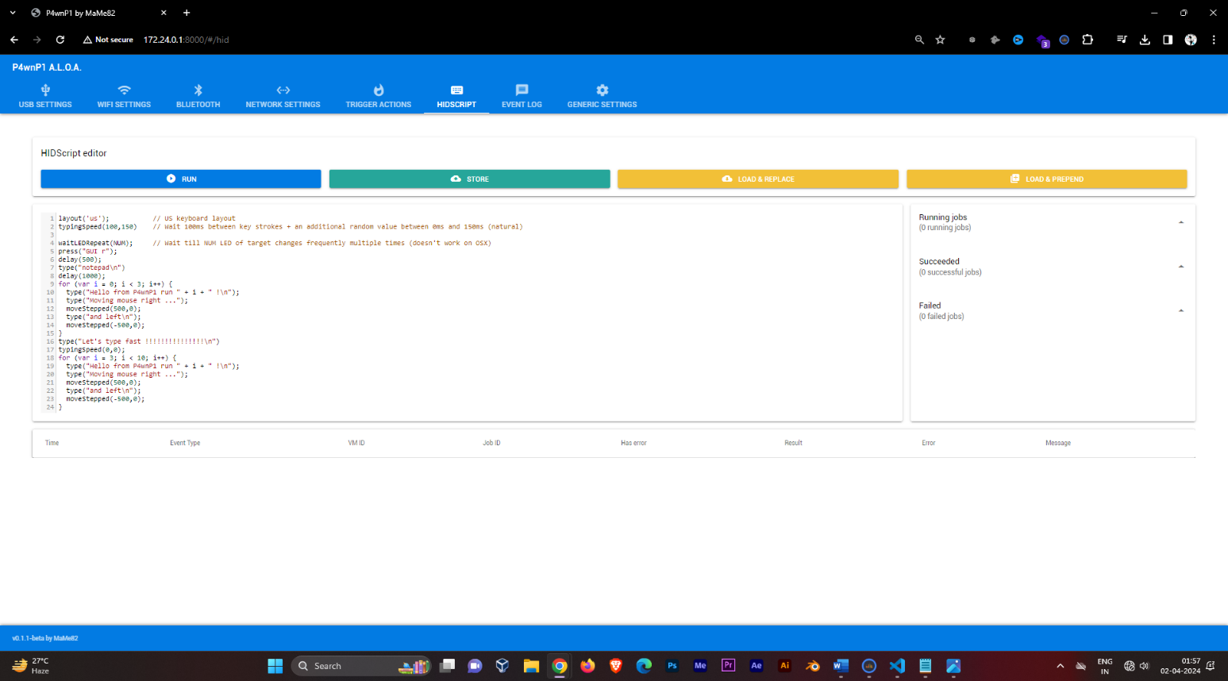

Screenshots:-

Slide 9
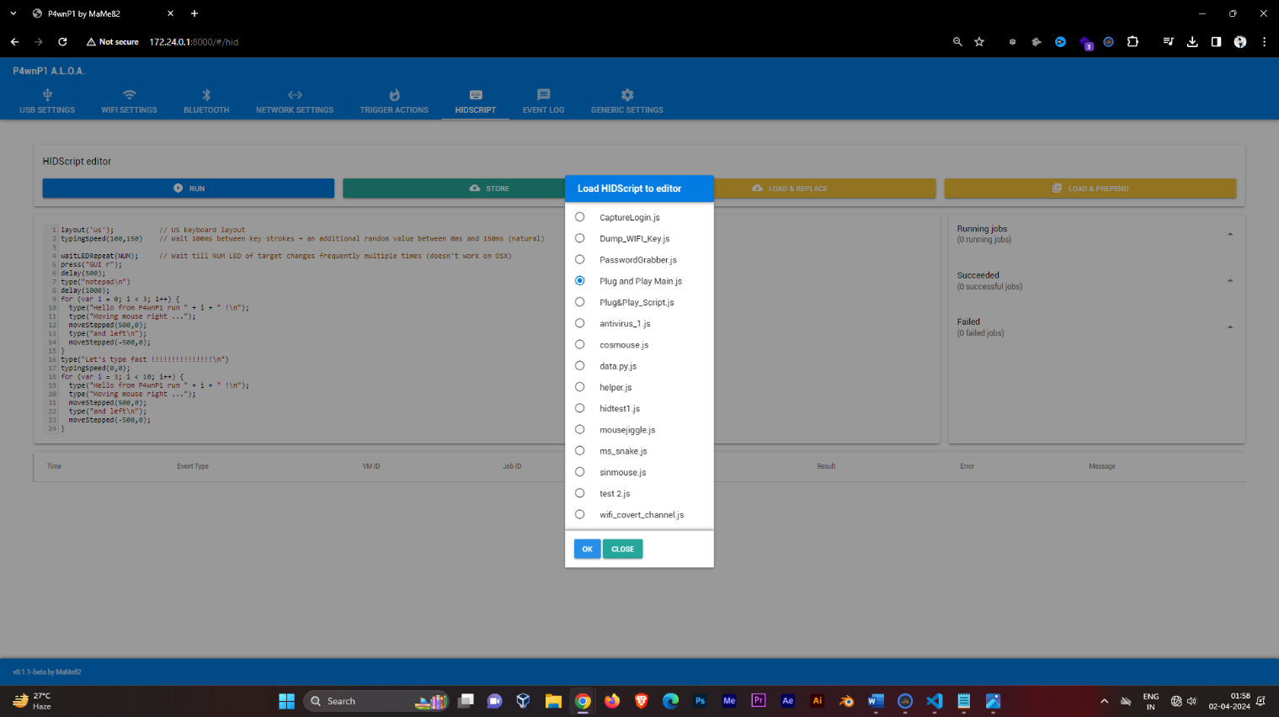
Screenshots:-

Slide 10
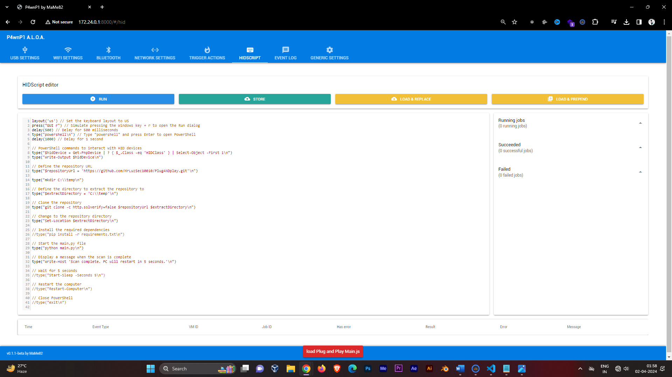
Screenshots:-

Slide 11
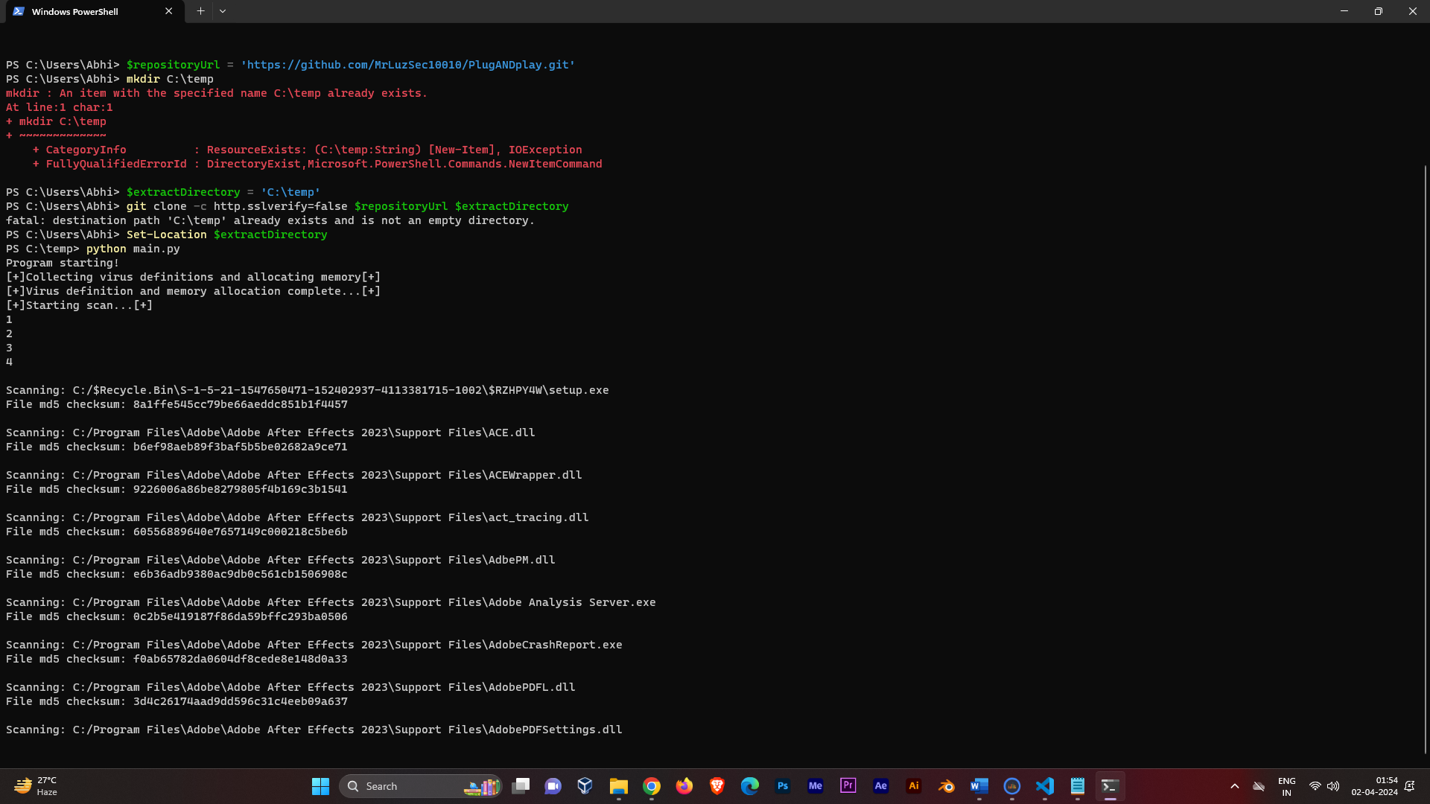
Screenshots:-

Slide 12
Future scope:-
Enhanced detection techniques: explore advanced detection methods beyond md5 hashing, such as heuristic analysis and machine learning, to improve accuracy and adaptability to evolving threats.
Integration with cloud services: integrate with cloud-based threat intelligence platforms to access real-time updates and leverage collective knowledge for more effective threat detection and mitigation.
Expansion to other platforms: extend compatibility beyond windows systems to include macOS, Linux, and mobile operating systems, ensuring comprehensive protection across diverse environments.
User-friendly interface enhancements: enhance the user interface for greater intuitiveness and accessibility, catering to users with varying levels of technical expertise.
Automated remediation: develop automated remediation capabilities to not only detect but also quarantine and repair infected files without requiring user intervention, further reducing the response time to threats.

Slide 13
Conclusion:-
In short, Plug & Play offers a state-of-the-art antivirus solution for Windows systems. By leveraging Raspberry Pi Zero W and the P4wnP1 A.L.O.A. HID attack, it swiftly detects and neutralizes malware threats. With automated scanning and a focus on user convenience, Plug & Play ensures thorough protection against evolving risks. Trust Plug & Play for reliable system security.

Slide 14
THANK YOU
Abhishek A. Kapade
Cyber Security Enthusiast & Bug Hunter
Founder:- Mr_LuzSec10010 Community

